Slide 1






Online Examination and Proctoring Platform
TEAM MEMBERS
2520030123
2520030232
Polisetty Sreeharsha
Adunuri Bhavana sri

Slide 2





Abstract
The Online Examination and Proctoring Platform is a web-based system designed to make online examinations easier to conduct and manage for both students and faculty. Faculty can create exams, add questions, schedule exams, and view results, while students can log in, attend exams within a given time, submit their answers, and view their results. The system stores student, examination, answer, and result details in a database.
The platform also provides basic proctoring features to record activities such as tab switching, exiting full-screen mode, and other suspicious actions during an examination. Faculty can review these activities along with the examination results. The main aim is to provide a simple and reliable platform for conducting online examinations while applying backend concepts such as authentication, APIs, database management, and secure data handling.

Slide 3








Problem Statement
Traditional online exam systems may not provide enough monitoring during examinations.
Managing exams, questions, students, and results manually can be difficult.
It can be challenging for faculty to identify suspicious activities during an online exam.
A simple system is needed to manage examinations and record important activities in one place.

Slide 4


Existing vs Proposed System
Existing System
Proposed System
Exam management may require multiple systems or manual work
Exam management in one platform
Basic proctoring and activity recording
Manual result management can take time
Results can be generated and stored digitally
Less control over suspicious activities

Slide 5
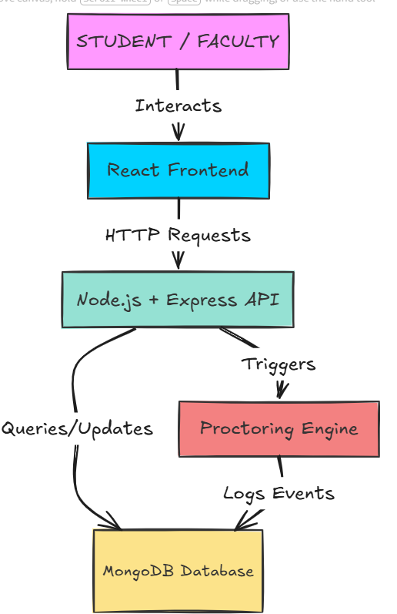
Workflow

Slide 6
















Tools Used
Frontend
Backend
Database
Development & Testing

Slide 7
Conclusion
The platform provides a simple and secure way to conduct online examinations.
It helps faculty manage exams and results while monitoring basic suspicious activities.
Overall, it improves the efficiency and reliability of online examinations.

